Slide 1
TOLL ROAD Example
The Toll Gate provides two payment methods to Florida motorists. One lane is dedicated to E-pass (or Sun-pass) customers. Payment using this option is electronic. Vehicles are equipped with a transponder that identifies the vehicle (and therefore the owner’s E-pass account) as it passes through the gate. A traffic light flashes green if the transponder’s signal was recognized, it flashes red if not. In either case, a camera captures the vehicle’s license plate image as the vehicle leaves the gate. The license plate can be used to bill the car owner if the transponder is not recognized. Electronic transactions are recorded locally at the Toll Gate in computer files and are then uploaded weekly to the central billing facility in Tallahassee.

Slide 2
TOLL ROAD Example
The second payment method is by cash transaction. One or more lanes may be dedicated to this payment method. Motorists must pay by cash and can optionally accept a receipt of their toll transaction. Change is given if the amount paid exceeds the amount of the toll. A toll gate arm prevents a motorist from proceeding through the gate until proper payment has been received. The toll attendant raises the toll arm when the transaction has been successfully completed. It is then lowered after a sensor detects that the vehicle has cleared the gate arm. Cash receipts are picked up daily by an armored security service.

Slide 3
TOLL ROAD Example
Identify Actors
Identify Use Cases
Identify Relationship between Use Cases

Slide 4
TOLL ROAD Example
The Toll Gate provides two payment methods to Florida motorists. One lane is dedicated to E-pass (or Sun-pass) customers. Payment using this option is electronic. Vehicles are equipped with a transponder that identifies the vehicle (and therefore the owner’s E-pass account) as it passes through the gate. A traffic light flashes green if the transponder’s signal was recognized, it flashes red if not. In either case, a camera captures the vehicle’s license plate image as the vehicle leaves the gate. The license plate can be used to bill the car owner if the transponder is not recognized. Electronic transactions are recorded locally at the Toll Gate in computer files and are then uploaded weekly to the central billing facility in Tallahassee.

Slide 5
TOLL ROAD Example
The second payment method is by cash transaction. One or more lanes may be dedicated to this payment method. Motorists must pay by cash and can optionally accept a receipt of their toll transaction. Change is given if the amount paid exceeds the amount of the toll. A toll gate arm prevents a motorist from proceeding through the gate until proper payment has been received. The toll attendant raises the toll arm when the transaction has been successfully completed. It is then lowered after a sensor detects that the vehicle has cleared the gate arm. Cash receipts are picked up daily by an armored security service.

Slide 6
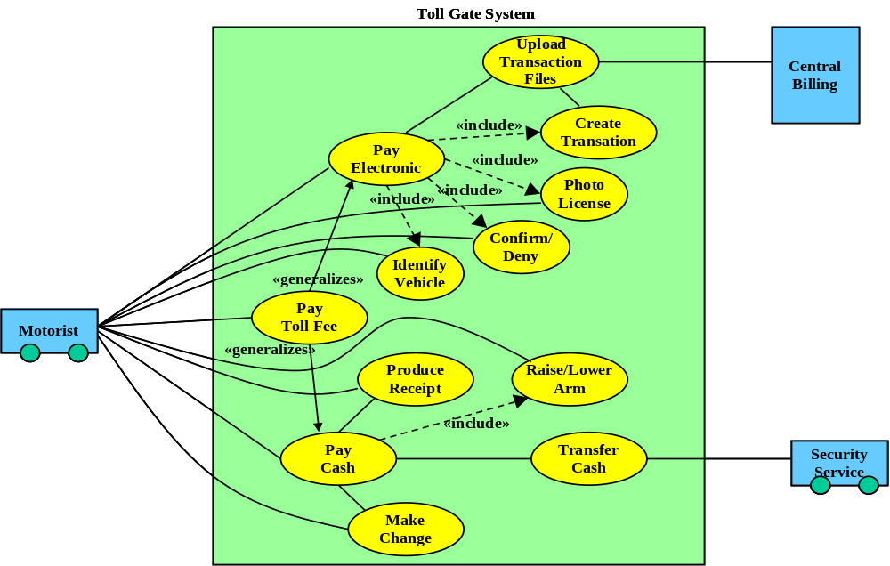
TOLL ROAD Example , Use Case Diagram

